Slide 1




Transforming the Experience of Care in the Home:
Opportunities and Challenges
April 9 and 10, 2018
Fisher Colloquium
McDonough School of Business
Georgetown University
Sponsored by:

Slide 2
Panel Two: Technologies that Enable Cross-Sector Collaboration
Brittany Weinberg – Aging2.0
Anne Tumlinson – Daughterhood.org
John Tschida – AUCD
Leigh Davison – Anthem
Sterling Harders – Carina (SEIU)
Lois Simon – Vela (Seniorlink)
Dirk Peters – CareGeneral
Diane Kaye – ClearCare

Slide 3
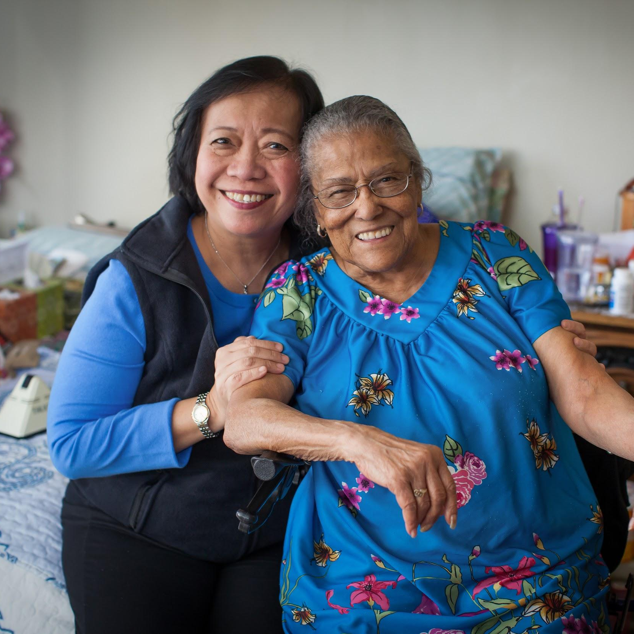
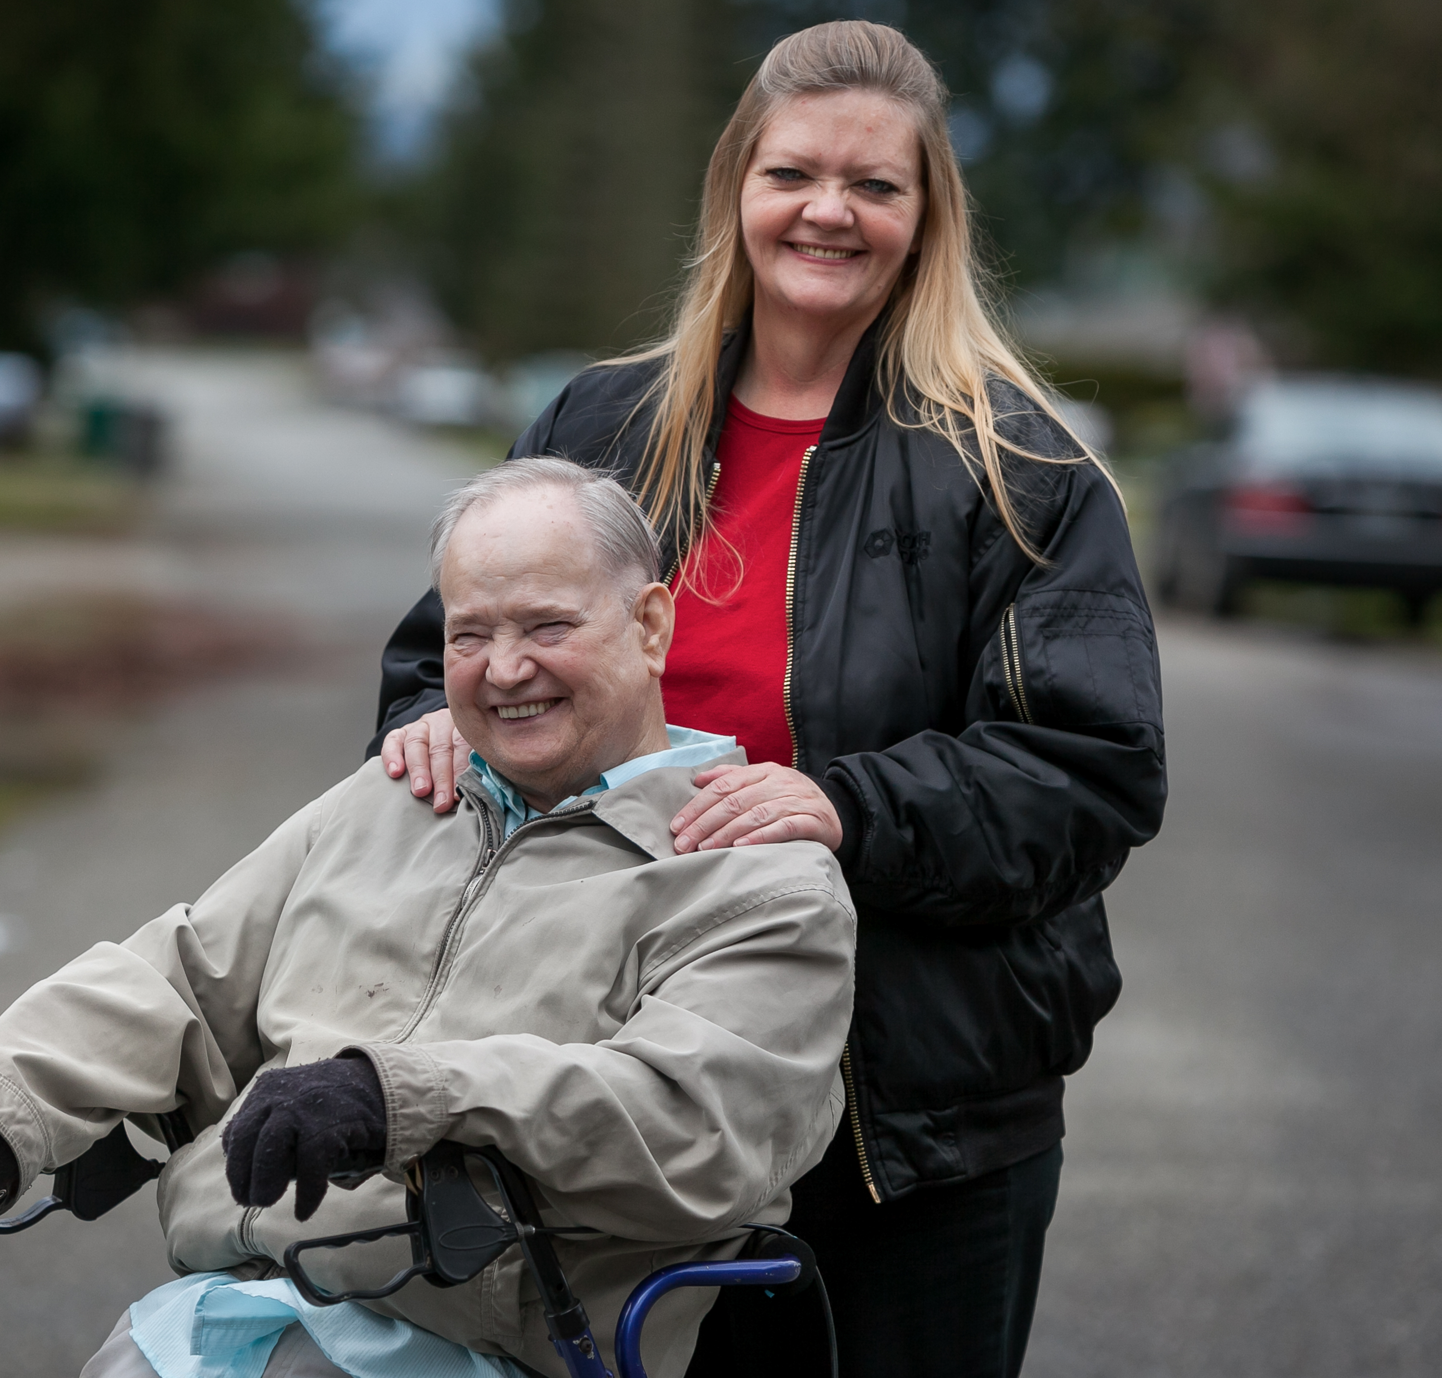


1
Overview
Context
Aging population with strong preference for home care; Consumer directed home care programs are popular and growing
Issue
Successful consumer directed programs require an accessible pool of qualified workers; workers need access to good jobs including good pay and full-time work hours
Opportunity
Technology can empower home care consumers and workers to easily, safely and directly find each other
carinacare.com
Notes:
How do consumers find and hire the right worker for their:
Geography
Care needs
Cultural fit
How do direct care workers find jobs that:
Match their location, schedule and skills
Can be quickly accessed for additional hours of gainful employment
How do employers/participants/managed care companies ensure participant directed programs :
Support participant choice
Meet gaps in care that arise from unavailability of the primary caregiver

Slide 4
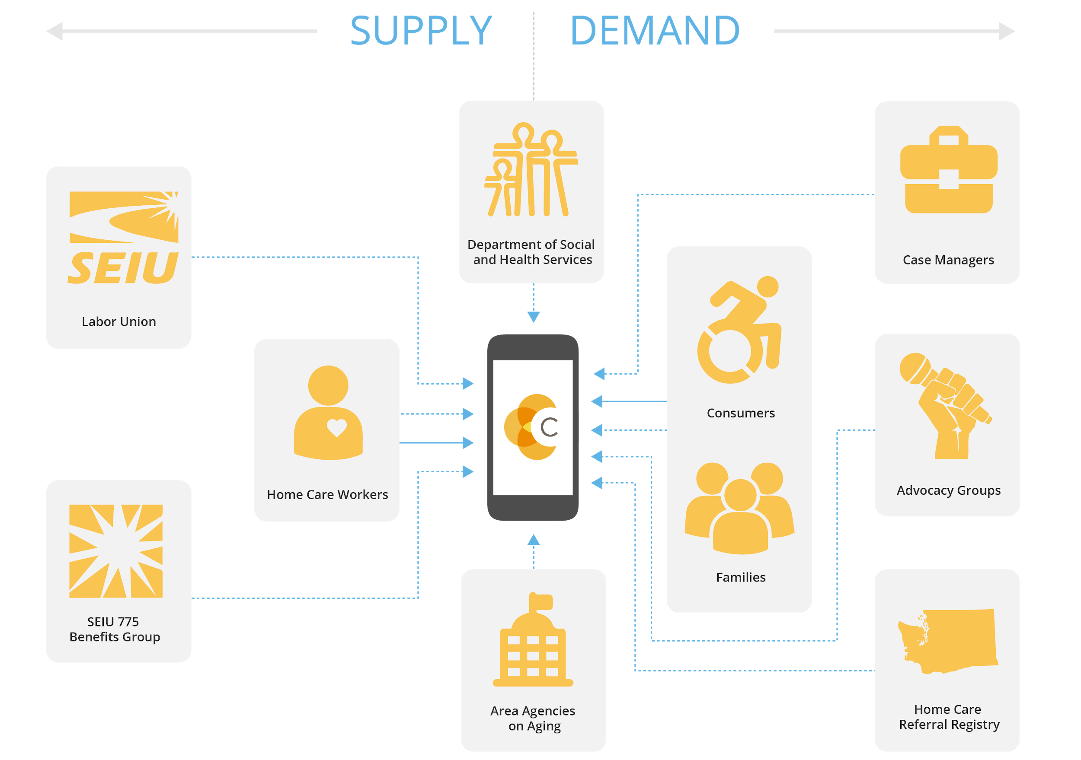

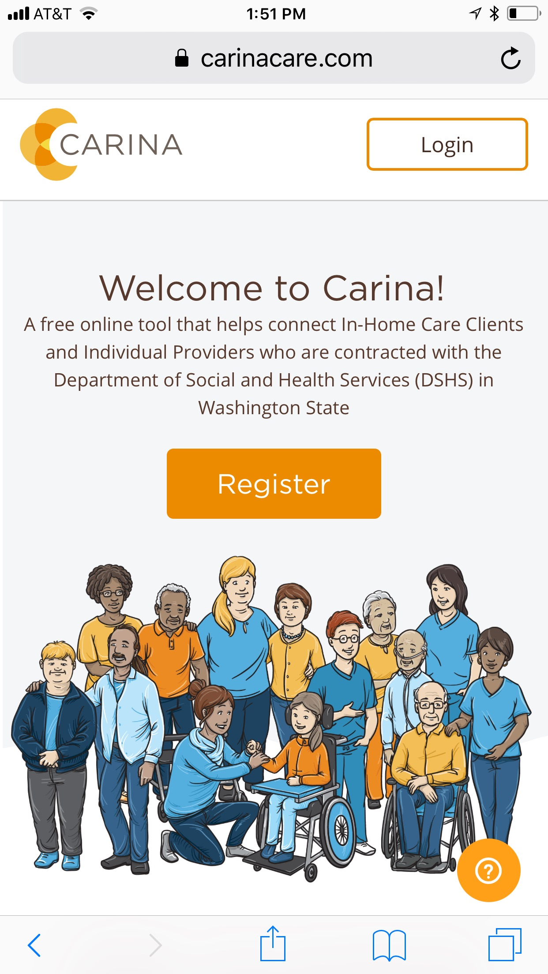
2
Use Case
carinacare.com
Notes:
Union and state sponsored effort could result in the creation of an effective tech solution for hiring for home care workers by Medicaid clients
By partnering with labor, the platform would be able to produce a steady labor supply
By partnering with the state, the platform would be able to produce a steady source of demand for workers
2 Sided
Balance the needs of workers and clients to create a valuable experience for connection
Security
Maintain top security standards including meeting HIPAA requirements
Accessibility
Ensure that any user of any ability level can access services on any device

Slide 5
3
Results
"I love using Carina because it helped me to find other clients and work this type of career full-time. I worked a job for 12 years in Portland wasting 3 hours a day in traffic wishing I could be somewhere else. Now I have a full-time, 40 hours a week working as a caregiver for three different people and loving every minute of it.”
- Gina, Care Provider, Kalama, WA
“I heard about Carina from my case manager, and after posting a job on the site, I received many responses from caregivers willing to work. I hired one whose schedule best fit my needs, and so far, everything is going really well! Carina was very convenient and easy to use. Everything I needed to find a caregiver was contained within the site.”
- Eric, Consumer, Vancouver, WA
2130 Individual Providers
Home Care Workers Registered for Carina
673 Home Care Clients
Home Care Consumers Registered for Carina
15,500 Monthly Hours
Hours of Home Care Jobs Filled using Carina
carinacare.com

Slide 6
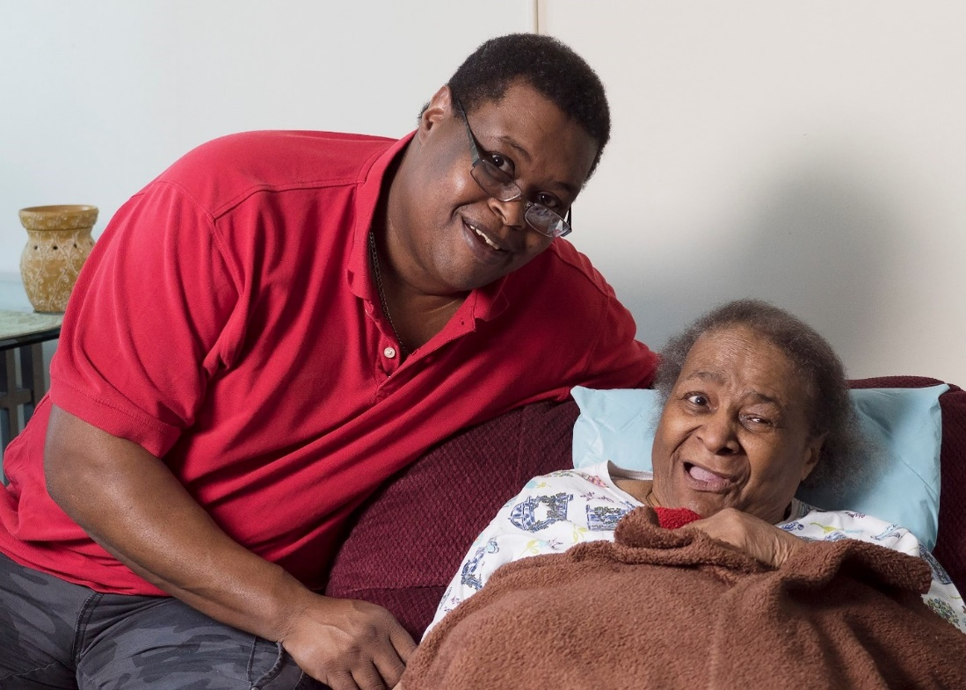
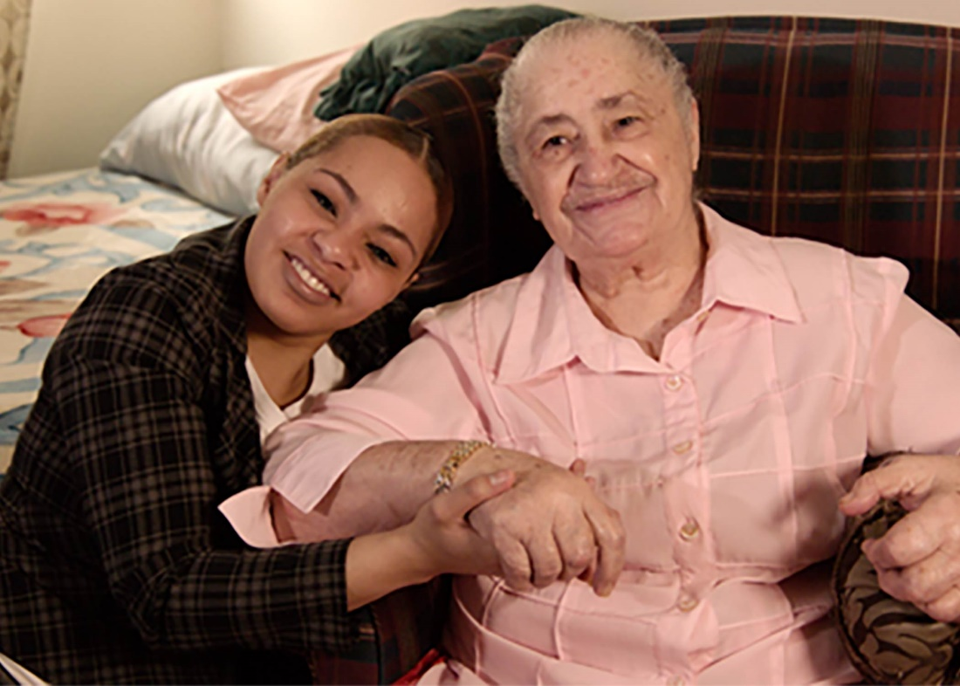

Vela: The Care Collaboration Platform from Seniorlink
April 9, 2018

Slide 7
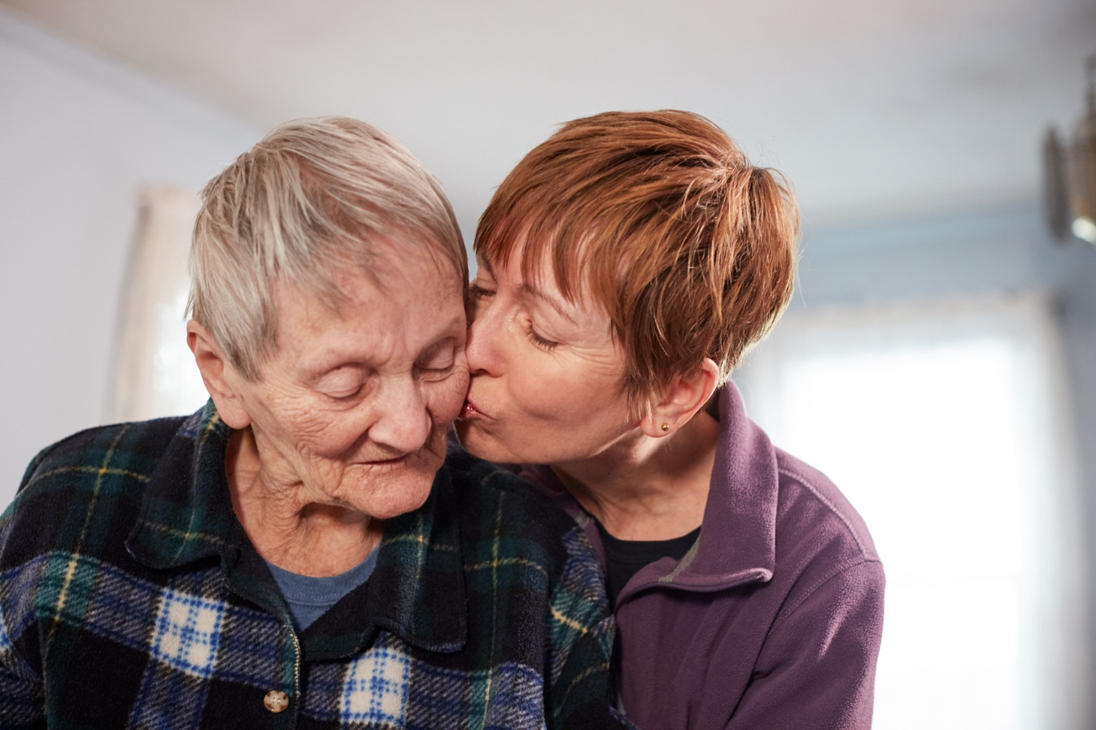
Meet Seniorlink
Seniorlink is a technology-enabled health services company transforming care management in the home
We bring nearly 20 years of experience working with family caregivers for complex individuals, with over 10,000 families served
Our care collaboration solutions combine human touch and technology to meaningfully lower costs and improve member engagement and satisfaction
Seniorlink’s vision is to mobilize and empower the nation’s 40 million family caregivers, turning them into valued care team members

Slide 8

From Fragmentation… to Collaboration
FROM
TO
INEFFICIENT, FRAGMENTED CARE COORDINATION
MORE EFFECTIVE AND INCLUSIVE CARE COLLABORATION
20% reach rate through telephonic outreach
Disjointed systems
Duplicative documentation
Increased risk of gaps
and miscommunication
98% reach rate through secure messaging
Centralized communication
Real-time notifications
Longitudinal record of care
Document/photo sharing, phone call recording, archiving and sharing
1
2
¹Ringlead, 2017, ²SMS Marketing Wallops Email with 98% Open Rate and Only 1% Spam, Mobile Marketing Watch, 2014, ³Vela User Survey, December, 2017

Slide 9

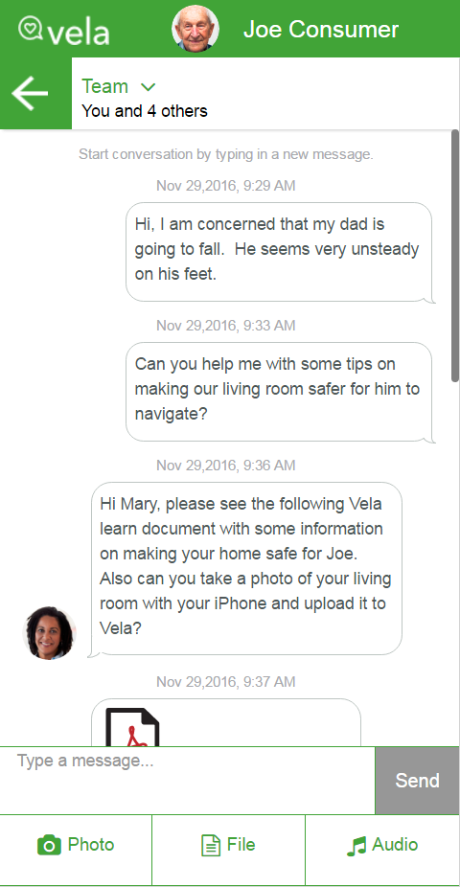



Meet Vela
With Vela…
Patients and caregivers are able to receive real-time coaching and support
Care Team
91
%
of patients and caregivers
Hi, I am concerned that my dad is going to fall. He seems very unsteady on his feet.
said it helps them feel more connected to their care teams and they are able to better communicate with them
Can you help me with some tips on making our living room safer for him to navigate?
Hi Christy, please see the following Vela Learn document with some information on making your home safer for Rich. Also can you take a photo of your living room with your iPhone and upload it to Vela?
Care teams are seeing better care plan adherence and improved efficiency
within their workflow.
89
of Care Teams using Vela
%
said it gave them a more accurate, detailed record of communication with patients and caregivers
Impact
vela is a HIPAA-secure
care collaboration platform
that modernizes how
interdisciplinary teams
communicate and collaborate
to deliver high-quality,
person-centered care.
Fewer adverse events
Reduced ER use
Reduced hospitalizations
Better medication adherence
Improved preventative care
More engaged caregivers
Reference: Seniorlink, data on file, Survey from December 2017

Slide 10

Engaging Vulnerable Consumers and Their Families to Improve
Health Outcomes
April 9, 2018

Slide 11
One Size Does Not Fit All
Vulnerable Consumers Face.....
Language barriers
Low literacy skills (reading and health)
Technology disparities
Feelings of distrust and lack of respect
Family members are critical but not integrated
Above leads to poor care plan adherence, high use of ER, unhealthy outcomes and bad patient experiences

Slide 12








Comprehensive SaaS Platform
HIPAA-Compliant, API-Driven, Single-Sign-On
Coordination
Communication
Virtual Support
Actionable Insights
Care Plans
Alerts & Reminders
Health Education
Community Resources
12

Slide 13





A Personalized Experience
Language and Culture
Technology Use/Preference
Health/Reading Literacy
Support Circle

Slide 14







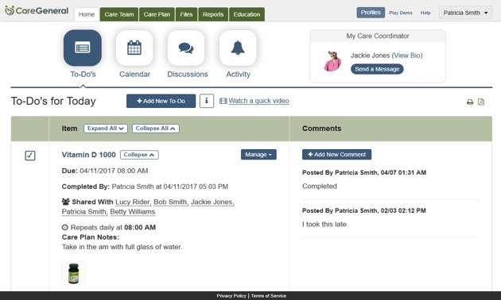









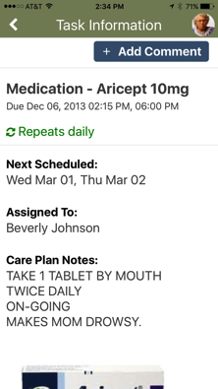

Use Case: Project REDI
Engage & Consent
Engagement/Education/Self-Monitoring
HRA/Screenings
Digital Health Platform

Slide 15
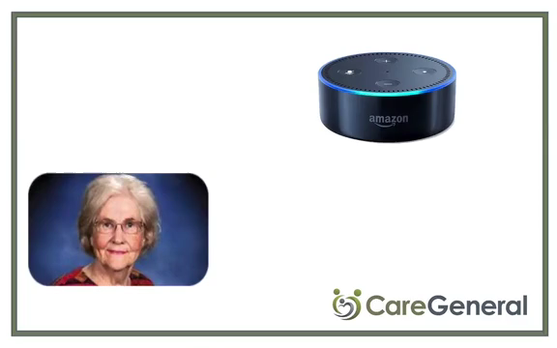
Alexa Skill

Slide 16
Introduction to ClearCare
April 9, 2018

Slide 17

Diane Kaye
Has worked across the healthcare continuum, with nearly two decades at high growth, venture backed companies.
Senior leadership and executive roles in client, operations, product and business development. Led through fundraising and liquidity events.
Most recent positions include:
Chief Operating Officer and SVP, Client Success, Candescent Health (acquired 8/17)
Chief Revenue Officer, Propeller Health
VP, Product and VP, Operations, athenahealth (IPO 2007)
Currently leading Healthcare Partnerships for ClearCare.

Slide 18




ClearCare’s SaaS platform powers the world’s largest network of home care agencies
ClearCare’s Home Care Network
4,000
home care agencies
500,000+ caregivers
over
200 million hours
$4 billion
of home care annually

Slide 19



















ClearCare is used “morning to night” by all home care agency staff and caregivers
MANAGE CAREGIVERS
DELIVER CARE
OPTIMIZE OPERATIONS
SUPPORT GROWTH
Caregiver Marketplace
Caregiver Safety
Billing & Payroll
CRM
Applicant Tracking
Smart Telephony
Overtime/ACA Tools
Referral Source Tracking
Caregiver Portal
Family Room
Reporting & Analytics
Marketing Tools
Employment Screening
WorkSafe Central
Payment Processing
Readmission Tracking
Work Comp Insurance
Tele-Health
Tax Credits
Preferred Partners

Slide 20











What is Home Care?
Home care agencies are the lowest cost providers serving highest cost patients (top 5%)
  Personal aides and CNAs in homes of seniors and those with ADL impairments to enable them to age-in-place
  Caregivers in the home
  on average
  20 hours per week for a year
  Historically Private pay
  and Medicaid
Provide help with things like
Dressing
Bathing
Eating
Medication Reminders
Housekeeping
Transportation
Exercise
Companionship

